Slide 1

Frequency Distributions
Chapter 2

Slide 2
Descriptive Statistics
Distributions are part of descriptive statistics…we are learning how to describe some data by first graphing it in a meaningful way.

Slide 3
Descriptive Statistics
Frequency distribution – describes the pattern of a set of numbers by displaying a count/percent for the values of the variables.

Slide 4
Frequency Distributions
Four different ways to visually describe just one variable:
Frequency table
Grouped frequency table
Frequency histograms
Frequency polygon

Slide 5
Let’s get some numbers
http://www.sporcle.com/games/g/corplogos3

Slide 6
Frequency Tables
Frequency tables include:
Values (all the possible numbers)
Frequency (how many times each number appears)
Percent/proportion
Why percent when we have frequency?

Slide 7
Frequency Tables
Grouped frequency tables are frequency tables where information has been clumped together.
For example, ABCD breakdowns instead of each grade individually. Or income ranges rather than each income separately.
Very useful for data with decimals and wide ranges of values.

Slide 8
Histograms
Histograms are frequency tables in graph form (basically they are turned on their side and made into a chart).
Gives you an idea of the shape of the distribution (notes after SPSS instructions).

Slide 9
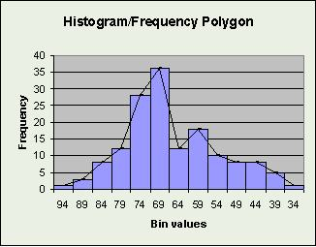
Frequency Polygon
Frequency polygons are histograms that aren’t shaded (although I don’t know why you wouldn’t just call it a histogram …).

Slide 10
Frequency Tables
SPSS instructions!
Just hit cancel on the opening screen.

Slide 11
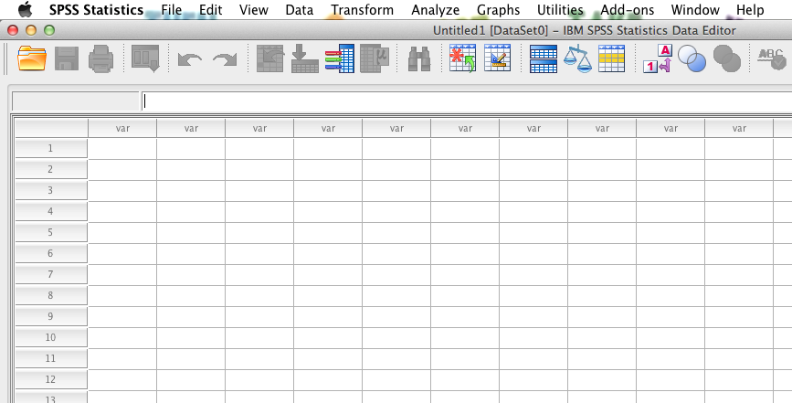
SPSS basics
Data view – where you enter data

Slide 12
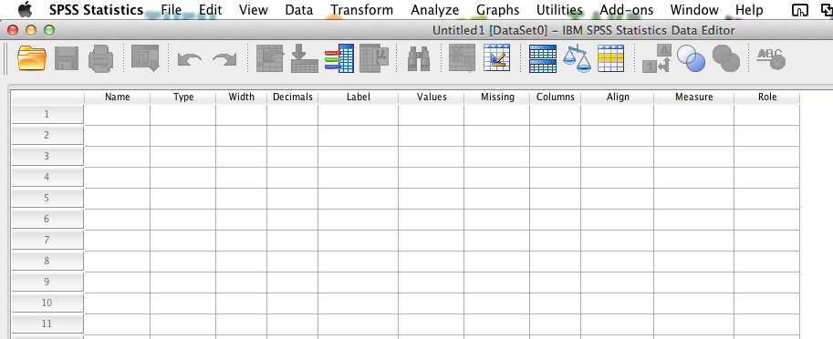
SPSS basics
Variable view – where you look at the variable types

Slide 13
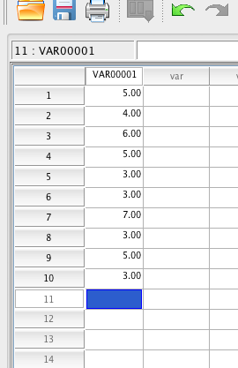
SPSS basics
To start, just enter some numbers.
You will get a variable name automatically.

Slide 14
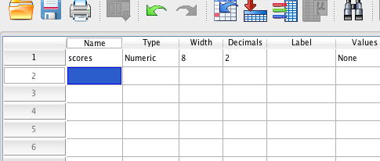
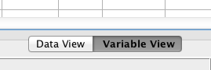
Click on variable view to change the name of the variable.

Slide 15
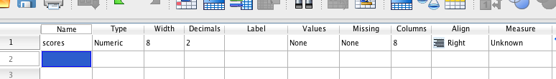
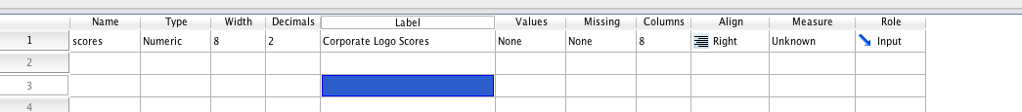
Variable “LABELS” are the space you can enter a proper variable name that will get transferred to the output.
Variable “NAMES” are the code SPSS uses to know what to run. No SPACES allowed. Some symbols are prohibited as well.

Slide 16
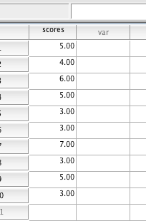
SPSS has a lot of bells and whistles (too many). You’ll get instructions with each chapter to not get confusing.
So let’s start with frequency tables.
How to enter data? You need ONE column with all the numbers you collected.

Slide 17
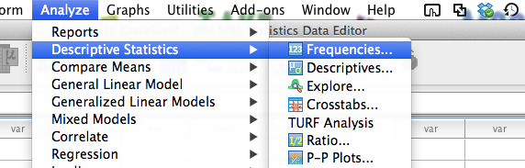
Click analyze > descriptives > frequencies.

Slide 18
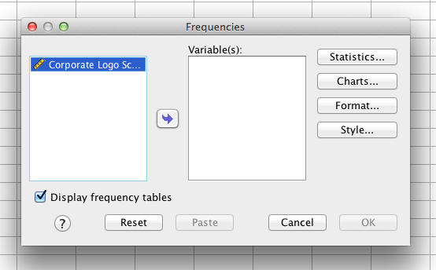
SPSS uses a system where:
Things on left = not using.
Things on right = using.
So you will have to move the variable over to the right to get a chart.

Slide 19
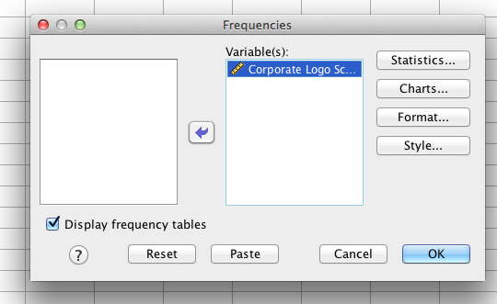
In this case, we want to leave the “display frequency tables” button checked.
Click charts (for histograms).

Slide 20
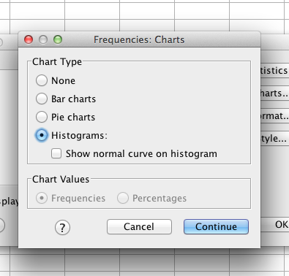
Click on the histogram button for the histogram.
You can check “show normal curve” if you want.

Slide 21
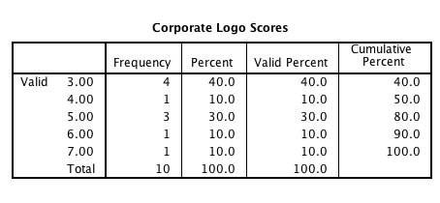
Hit ok to get output (comes up in a different window).
Frequency table:

Slide 22
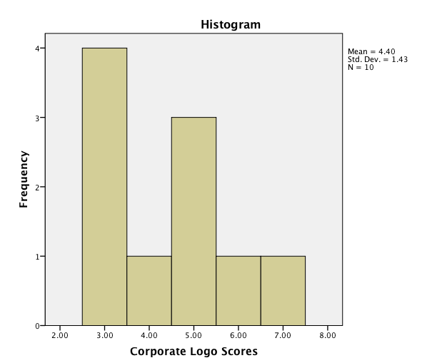

Slide 23
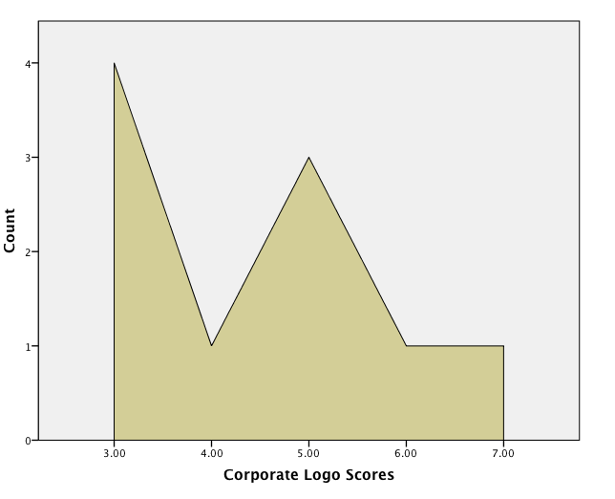
We will talk about how to do these next time with chart builder.

Slide 24
Shapes of Distributions
Unimodal
(normal distribution)
Bimodal
Multimodal
Rectangular

Slide 25
Shapes of Distributions
Normal distributions: Specific frequency distribution
Bell shaped
Symmetrical
Unimodal

Slide 26
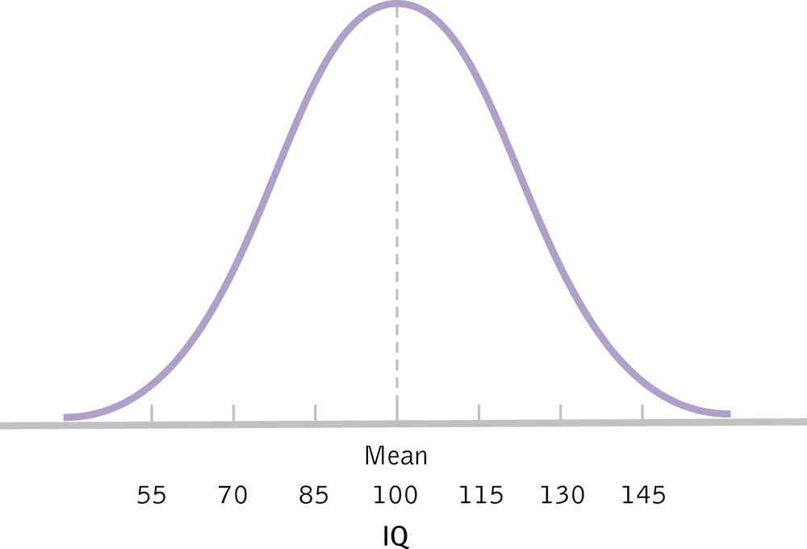
The Normal Distribution

Slide 27
Skewed Distributions
When our data are not symmetrical
Positive: tail to the right
May represent floor effects
Negative: tail to the left
May represent ceiling effects
Memory hint: skew is where the tail is (the cat!)

Slide 28
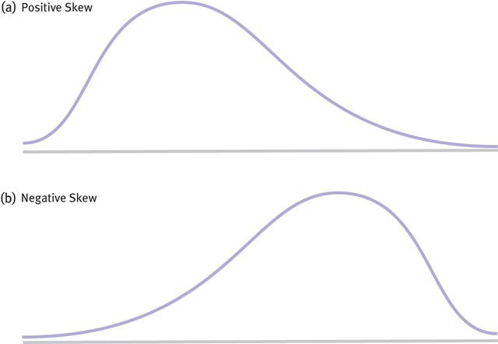
Two Kinds of Skew

Slide 29
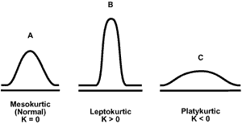
Kurtotic Distributions
Kurtosis – how much a distribution deviates from normal by looking at spread

